Slide 1


SMO-KARE

Slide 2
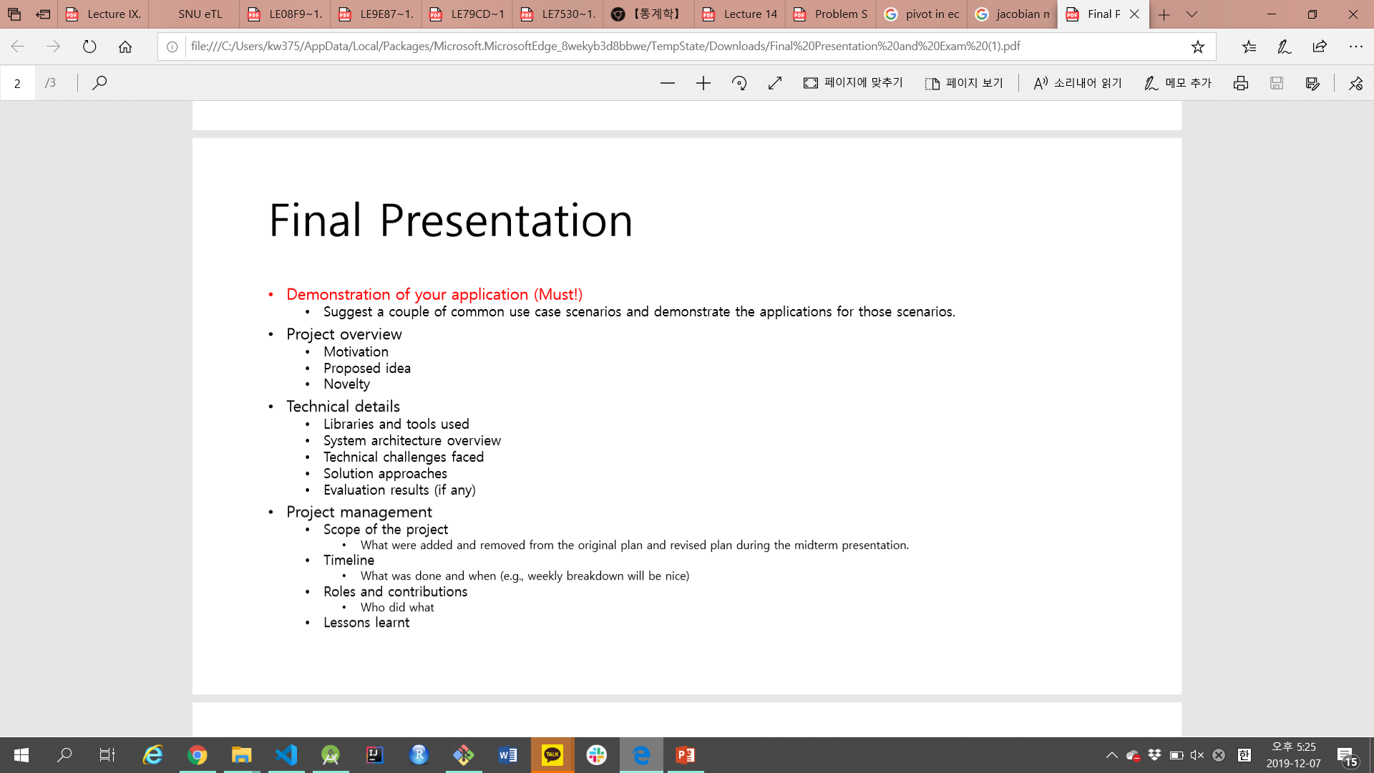

Slide 3



SMO-KARE
IDEA
TRACK
SEND
PROCESS
TRACK your motion & collect raw-data with Wearable Device
SEND your data to the phone
PROCESS raw-data with a various tools
Obtain useful information

Slide 4
SMO-KARE
Until Midterm
TRACK
SEND
PROCESS
TRACK your motion & collect raw-data with SMART PHONE
SEND your data to the phone
PROCESS raw-data with a various tools
Obtain useful information

Slide 5
SMO-KARE
Final Term
TRACK
SEND
PROCESS
TRACK your motion & collect raw-data with SMART PHONE
SEND your data to the phone
PROCESS raw-data with a various tools
Obtain useful information

Slide 6
SMO-KARE
Final term
TRACK
SEND
PROCESS
TRACK your motion & collect raw-data with SMART PHONE
SEND your data to the phone
PROCESS raw-data with a various tools
Obtain useful information

Slide 7
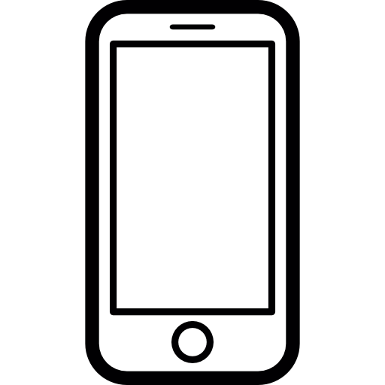
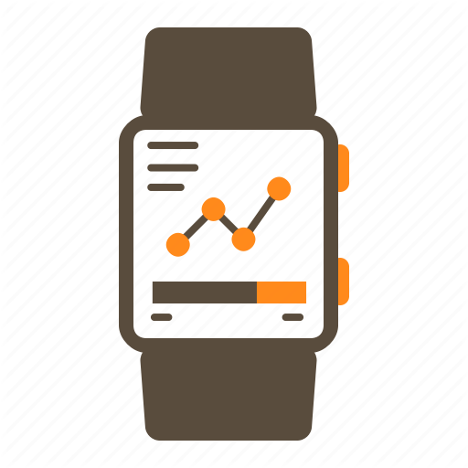
System overview
HOME
INPUT
TIMELINE
Wear Service
REPORT
Data Service
SETTING
Data Layer API
Data Layer API

Slide 8
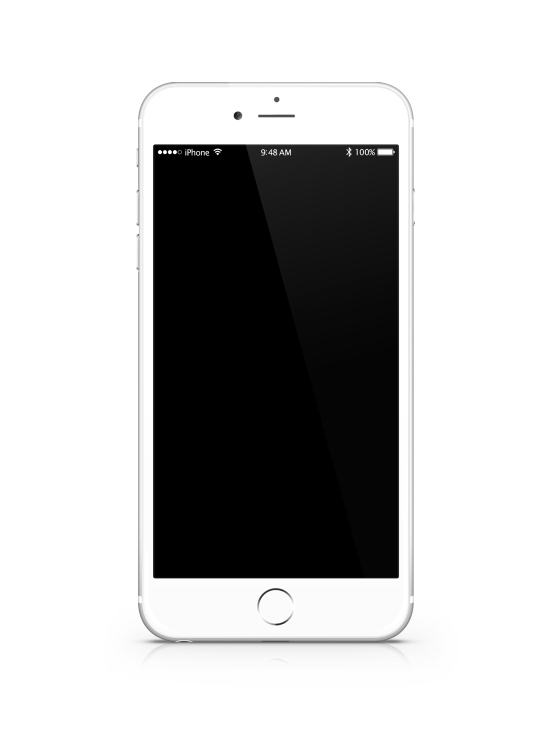
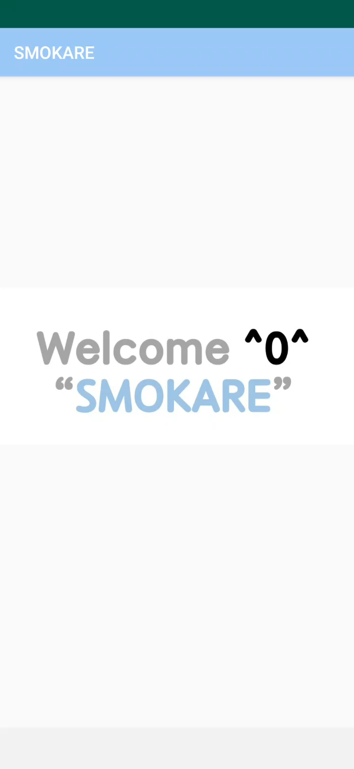
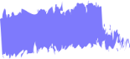
User scenario
HOME
First Download the app
After ‘welcome page’ for 2 seconds
‘Info Page‘ in which user write down info about user.
This info will be used in other page.

Slide 9
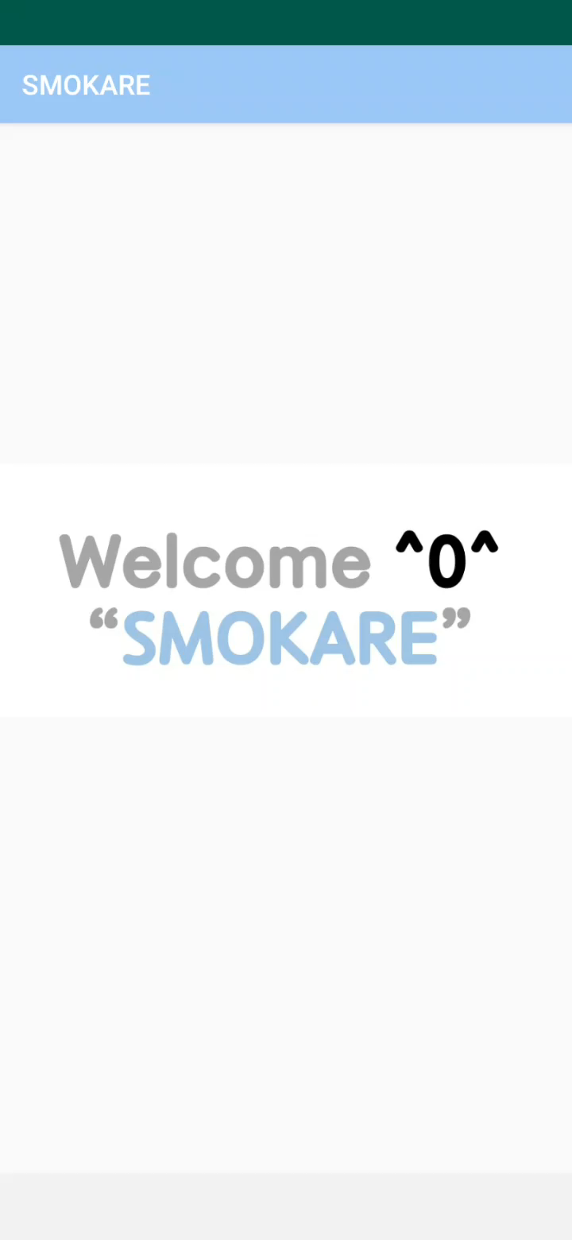
User scenario
HOME
Main PAGE
HOME tab in the bottom, would be main page of app
User can add their own smoking information with the button
Below, there are several information about:
Today‘s total cigarettes/This week’s total cigarettes,
And the time since the last smoking

Slide 10
User scenario
HOME
Setting TAB
Since you initially entered information about the user, when you start the app, you'll be taken directly to the home screen.
Setting shows the user information.

Slide 11
User scenario
HOME
Timeline TAB
After adding some records, we can use this TAB
The user can check the smoking history at a glance while viewing the statistics on his smoking history.
Below mushroom will give you comments according to your smoking history.

Slide 12
User scenario
HOME
Report TAB
The user can set a smoking cessation goal on this page.
The progress bar tells you how much you have reached your smoking cessation goal.
Underneath it are real-time savings, extended life, depending on the time you quit.

Slide 13
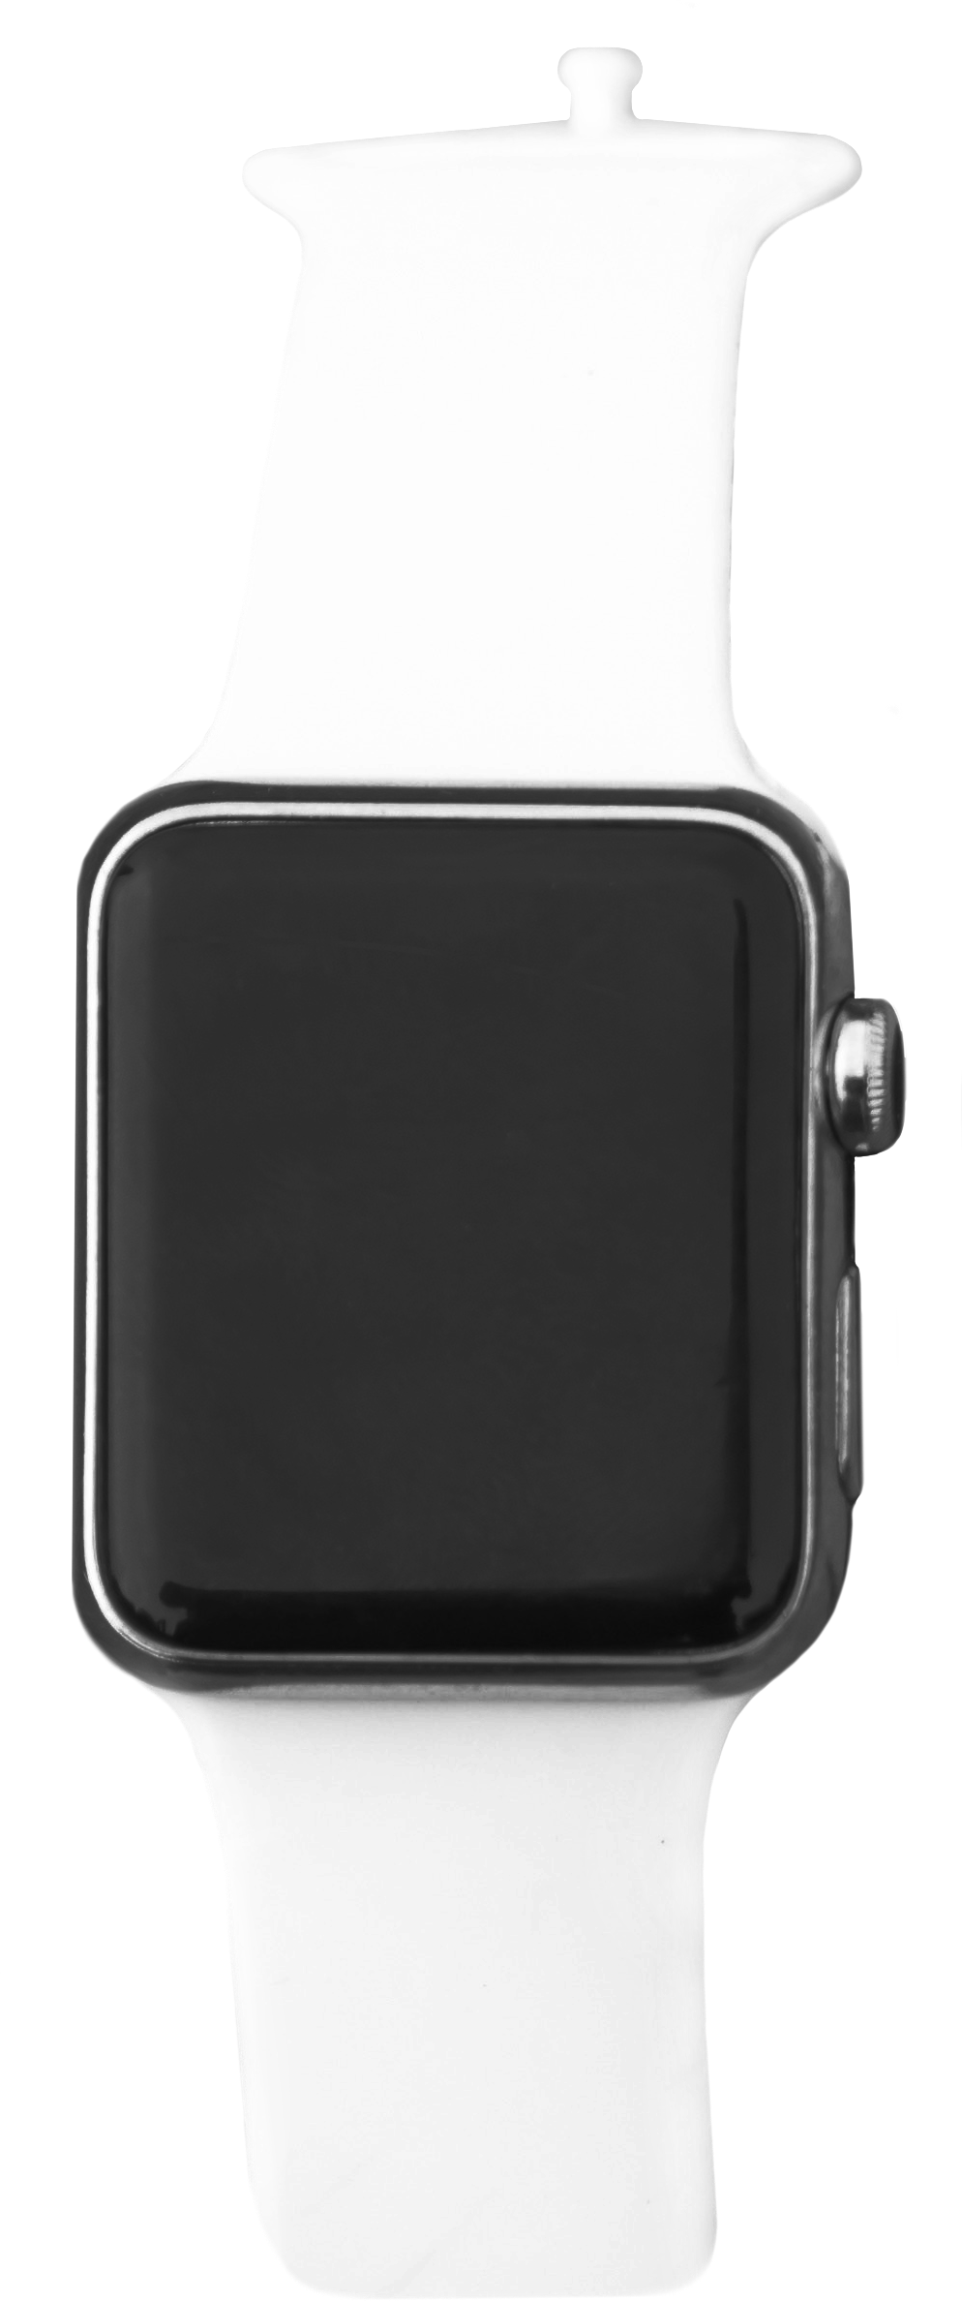
KEY challenges & solutions
KEY CHALLENGES
METHOD of processing the raw-data
COMMUNICATION between smartphone and smartwatch
REAL-TIME processing on 24 hours

Slide 14
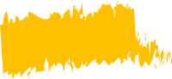
KEY challenges & solutions
METHOD of processing the raw-data
1. Use ACCELEROMETER, MAGNETIC_FIELD sensor to calculate roll, pitch angle
2. Examine the roll, pitch angle whether they are in ‘dragging angle range’
3. In order to recognize smoking one cigarette, a person has to drag at least seven times in 4 minutes

Slide 15
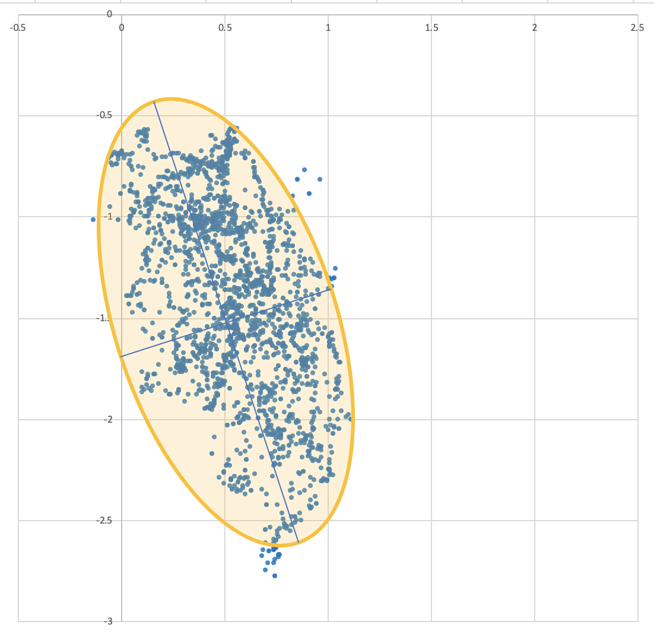
KEY challenges & solutions
METHOD of processing the raw-data
2. Examine the roll, pitch angle whether they are in ‘dragging angle range’
4 trials, overall 16000 pitch & roll data
Make the elliptic equation as ‘dragging angle range equation’

Slide 16
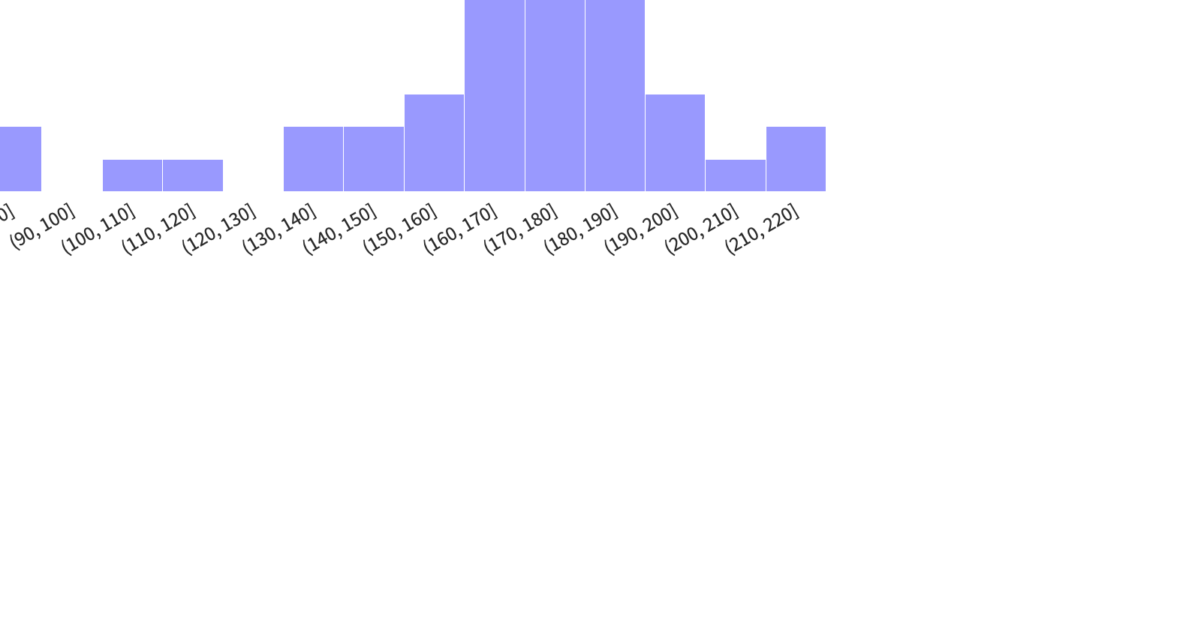
KEY challenges & solutions
METHOD of processing the raw-data
3. In order to recognize smoking one cigarette, a person has to drag at least seven times in 4 min
Smoking time < 4 min
96% of drags per cigarette ≥ 7
240 sec

Slide 17
KEY challenges & solutions
COMMUNICATION between smartphone and smartwatch
We use “Data Layer API” of Wear OS using Bluetooth
Wear OS : Use Wearable.getDataClient class to send timestamp information of smoking action Phone : Use DataClient.onDataChangedListener in the background service
Sample network structure in Wear OS official document
https://developer.android.com/training/wearables/data-layer

Slide 18
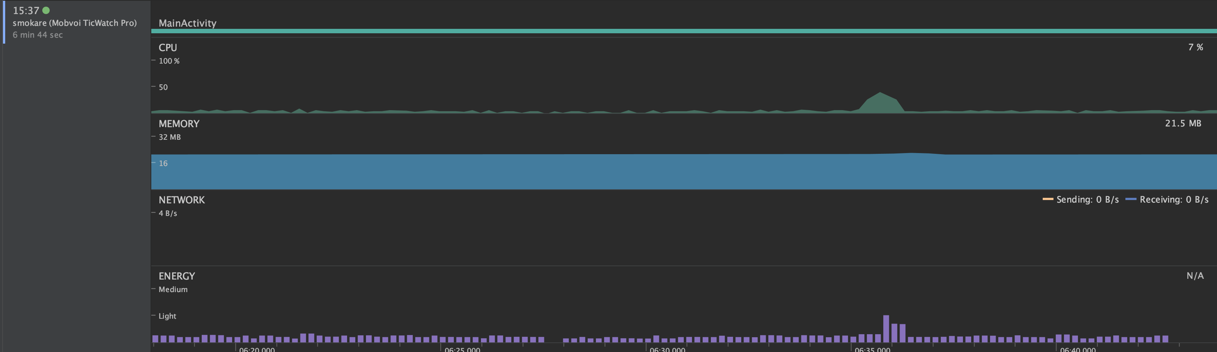
KEY challenges & solutions
REAL-TIME processing on 24 hours
Use Foreground Service to operate detection app continuously in Smartwatch
It consumes a small mount of energy and resources.
The watch already use sensors to see whether the user is looking at the screen or not.

Slide 19
SUCCESS CRITERIA
GOAL 1
Can our app detect smoking behavior accurately?
: Yes. We did some experiments to verify our detection model (TBC).
GOAL 2
HIGH
OK
Can user get useful information to quit smoking?
: Yes, as you saw in the UI demo, it provides some useful information to the user.
ACCURACY
EFFICIENT
24/7
GOAL 3
STABLE
Is our app stable during all the time?
: It’s working well but Not perfectly.
Sometimes the app stops responding.
goals

Slide 20
Demonstration & Verification
GOAL 1
Can our app detect smoking behavior accurately?
10 smokers wore the smartwatch and check whether the app detect their smoking motions correctly. - 100% success (true positive)
2 non-smokers wore the smartwatch for three hours in daily life (sitting, studying, walking, drinking a soda and eating).
- 1 detection error (false positive) was occurred.

Slide 21
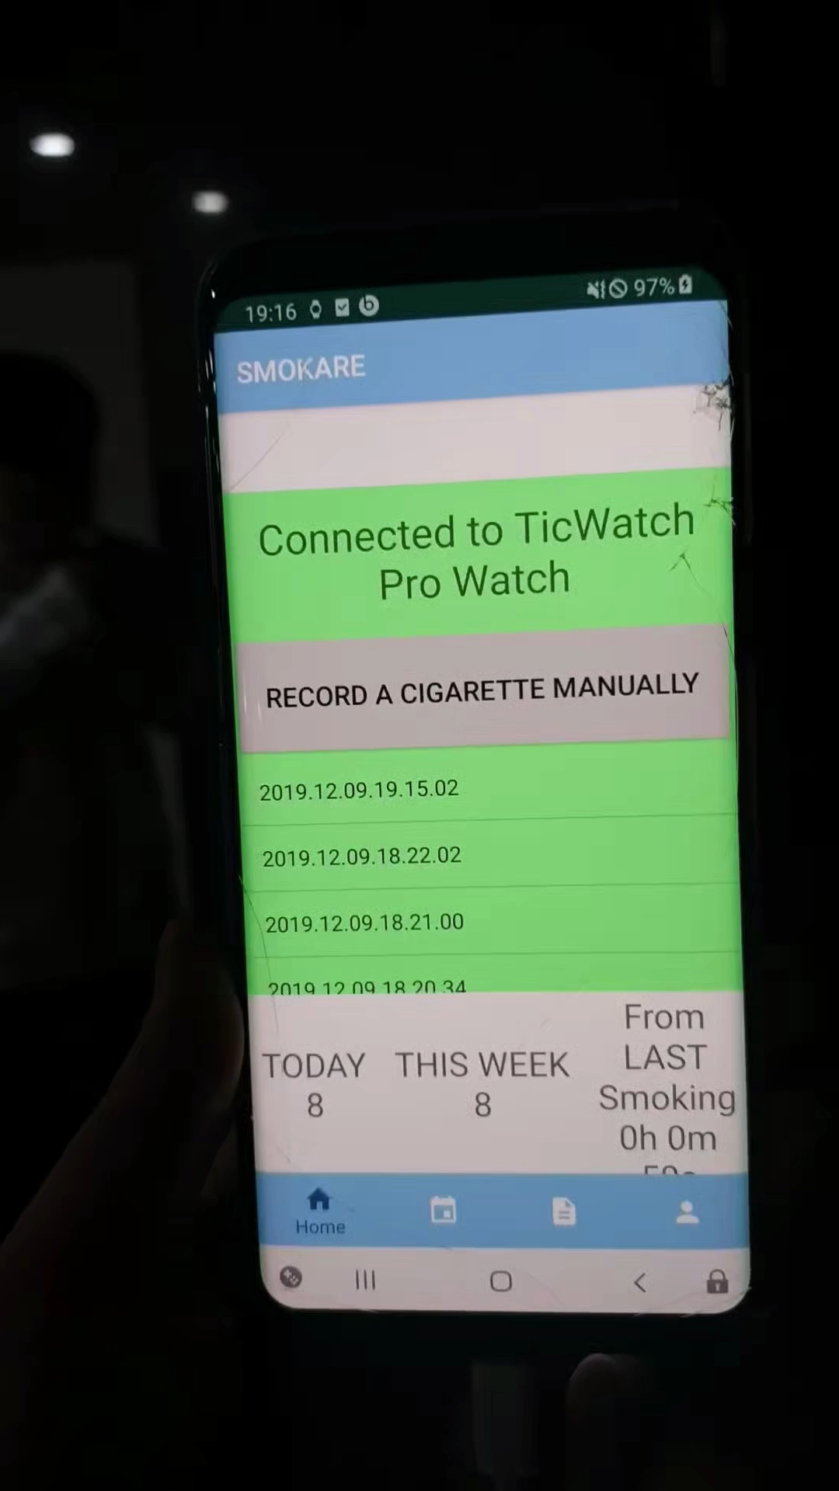
Demonstration & Verification
GOAL 1
Can our app detect smoking behavior accurately?
10 smokers wore the smartwatch and check whether the app detect their smoking motions correctly. - 100% success (true positive).

Slide 22
Timeline
Timeline
Week | 3 | 4 | 5 | 6 | 7 | 8 | 9 | 10 | 11 | 12 | 13 | 14 | 15
Presentation |  | Proposal |  |  |  |  |  | Midterm |  |  |  |  | Final
Topic Selection
System Design
[App] UI
[Watch] Sensor Data Processing
[Watch] Detection
[App] Function
[Watch] Background Running
Data Transfer from Watch to App
Notes:
2행, 3행 사이 선 굵게

Slide 23
Contributions
Contributions
Pair | App |  | Watch
Name | Eunman | Kyung-won | Seung-geon | Yujin
System Design | ✔️ | ✔️ | ✔️ | ✔️
[App] UI | ✔️ | ✔️
[App] Function | ✔️ | ✔️
[Watch] Sensor Data Processing |  |  | ✔️ | ✔️
[Watch] Detection |  |  | ✔️ | ✔️
[Watch] Background Running |  |  | ✔️ | ✔️
Data Transfer from Watch to App | ✔️ | ✔️ | ✔️ | ✔️
Notes:
2행, 3행 사이 선 굵게

Slide 24
Lessons Learnt
Lessons
Fully understanding Android must be preceeded before developing.
Task distribution should be as independent as possible.
Notes:
1. 안드로이드에 대해 기초부터 이해하고 개발을 시작해야 한다.
4대 컴포넌트: Activity, Service, Broadcast receiver, Content provider
https://limkydev.tistory.com/31
2. 역할 분담을 최대한 독립적으로 해야한다.
3.

Slide 25
THANKS!

